Slide 1

Exploratory Data Analysis Report on AMEO Dataset
A. Renuka sri

Slide 2
About me
I am Renuka Sri . I have completed my B. Tech in 2023.
I'm drawn to data science for its dynamic blend of analytical rigor and creative problem-solving. In today's data-rich world, I see data science as a gateway to unlocking the untapped potential hidden within vast datasets. By harnessing the power of data science, I'm equipped to derive meaningful insights, identify patterns, and make informed decisions that drive tangible impact.
Ultimately, my choice to pursue data science stems from a deep-seated belief in its transformative potential to revolutionize industries, improve lives, and shape the future.
LinkedIn profile: https://www.linkedin.com/in/renuka-sri-annem
GitHub profile: https://github.com/renuka7515

Slide 3
Agenda
Business Problem: Analysing the data with respect to the target variable Salary
Objective of the Project
The goal of this Exploratory Data Analysis (EDA) is to extensively investigate the provided dataset, with a particular emphasis on understanding the link between various variables and the target variable, Salary.
Summary of the Data
The Aspiring Mind Employment Outcome 2015 (AMEO) dataset, released by Aspiring Minds, focuses on employment outcomes for engineering graduates. It includes dependent variables such as Salary, Job Titles, and Job Locations, along with standardized scores in cognitive skills, technical skills, and personality skills. With around 40 independent variables and 4000 data points, these variables encompass both continuous and categorical data. The dataset also includes demographic features and unique identifiers for each candidate.
Exploratory Data Analysis:
Data Cleaning Steps
Data Manipulation Steps
Univariate Analysis Steps
Bivariate Analysis Steps
Research Question
Conclusion

Slide 4
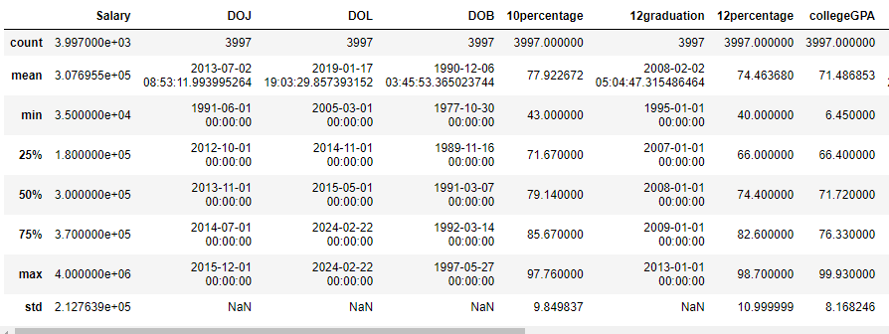
DATA CLEANING
Dropped the columns like ID, Unnamed:0, College ID, College city ID and some columns which are not important for analysis.
Datatype conversions. Some of the columns like Date of joining, Date of leaving, Date of Birth, Graduation Year are in other data types .so I converted them into date datatype.
Final data set contains 3997 rows and 28 columns.
We can clearly observe the following findings:
Minimum salary of a person is 35 thousand
Maximum salary of a person is 40 lakhs
Average 10th percentage is 77.92 %
Average 12th percentage is 74.46 %
Average college GPA is 71.48 %
Maximum 10th percentage is 97.7%
Maximum 12th percentage is 98.7 %
Maximum college GPA is 99.93 %

Slide 5
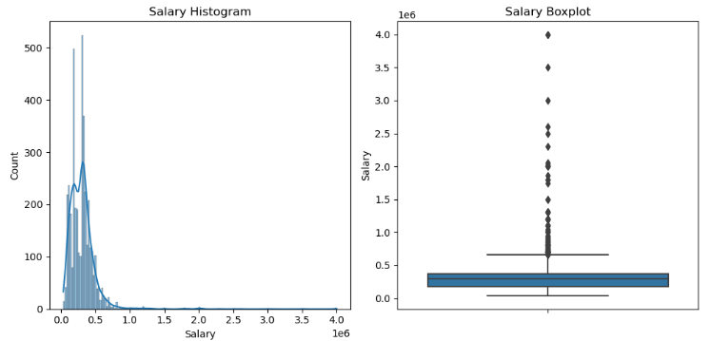
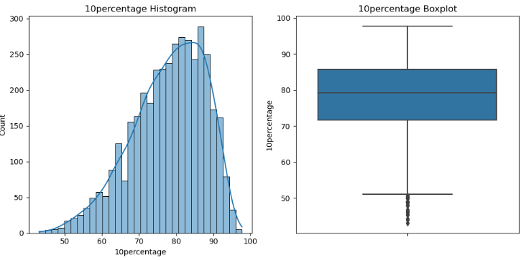
UNIVARIATE ANALYSIS
From hist and box plot of Salary
there are 500 people in the data set who earn a salary less than 5 lakhs INR, and there are 100 people who earn a salary between 2.5 and 3.0.
From hist and box plot of 10percentage
there are very less persons who scored less than 50%, and there is a increase in the density in between 79-87%
there are few outliers at lower whisker which are < 50 % only

Slide 6
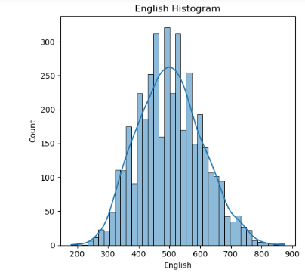
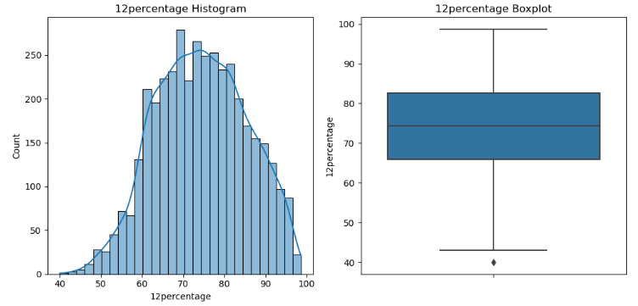
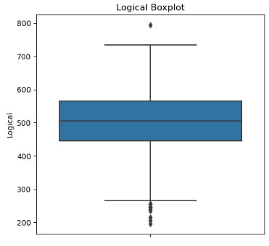
From hist and box plot of 12percentage
there are more people whose percentage is >65 and <85
Around 300 people got >450 and <550 but only few people approximately 20 people who got highest score > 800
most of the people scored between 500 to 600 but only one got scored highest with 800

Slide 7
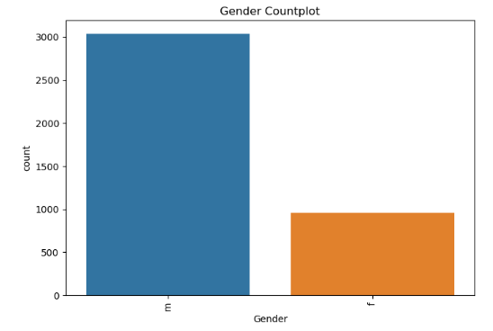
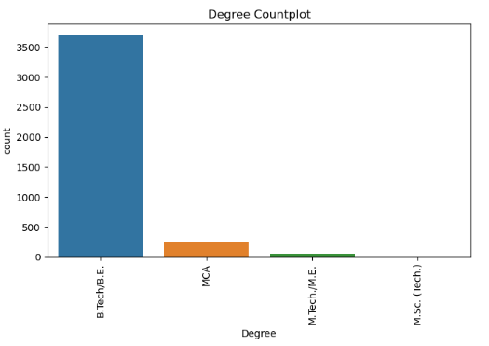
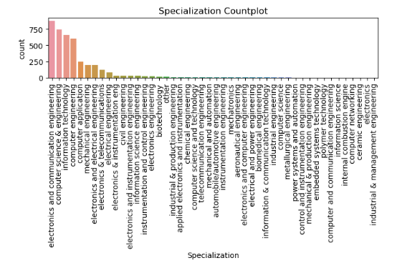
There are more males employees compared to female employees
Most of the employees are B.Tech/B.E graduates only and then from MCA but No one is from M.Sc.
Most of the Graduates Specialization is Computer Science and Electronics & Communication Engineering and Information Technology

Slide 8
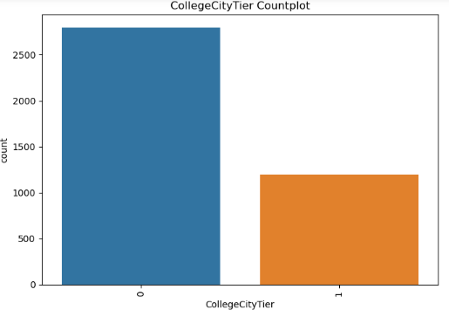
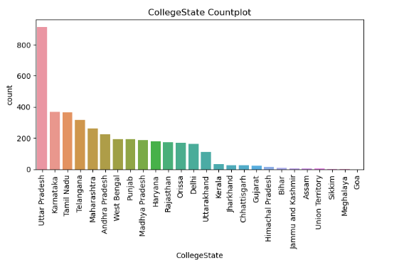
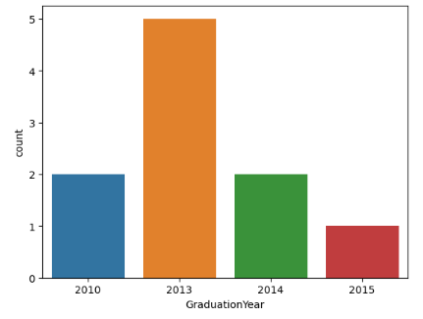
Most of them are from collegecityTier 0
Most Gradates college state is Uttar Pradesh and then Karnataka and then Tamil Nadu
Most of the employees passed out in the year of 2013 and then 2010 and 2014

Slide 9
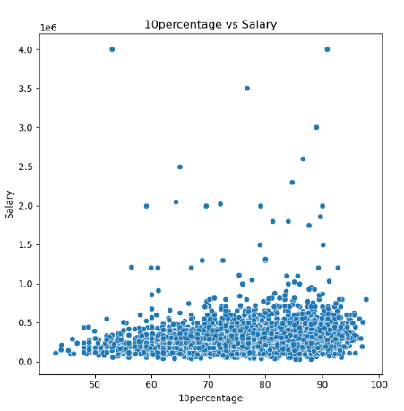
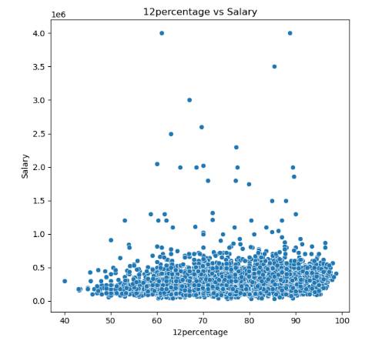
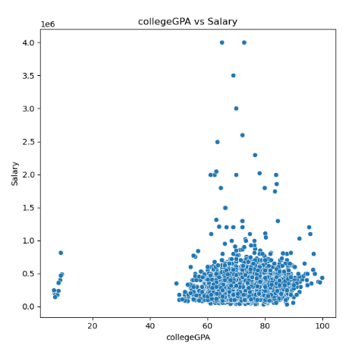
BIVARIATE ANALYSIS
From the above plots we can observe that
as increase in percentage there is a slight increase in salary based on the 10th and 12th percentages but most of the employees salary is minimum which is less than 500000 only. it increases irrespective of their percentages.
But when it comes to college GPA vs Salary only the graduates which GPA >60 percentage has salary less than 5 lakhs but few people with percentage >75 has raise in salary between 10-40 lakhs.

Slide 10
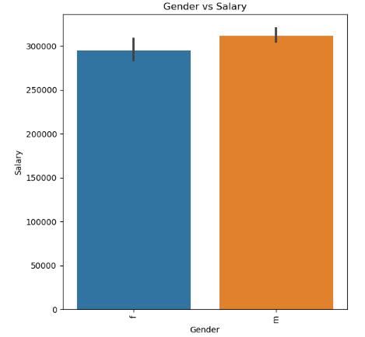
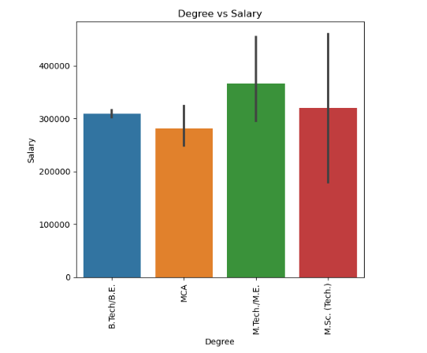
From the plot Gender Vs Salary
Approximately Male and Female employees has similar salaries
From the plot degree Vs Salary
The employees who did M.Tech has High salaries compared other degrees

Slide 11
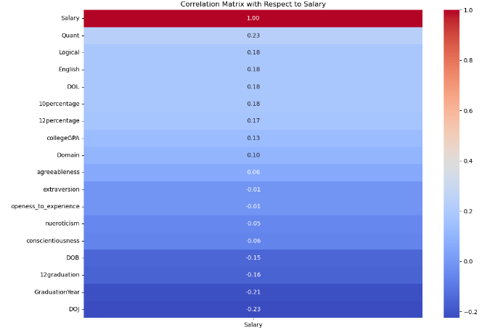
Every feature is non related to salary. Each and every feature is independent.

Slide 12
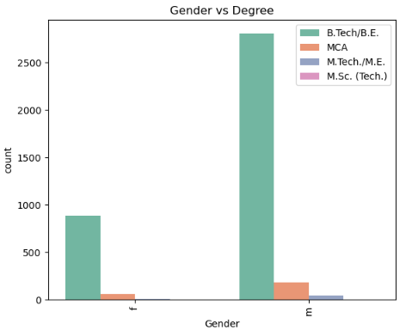
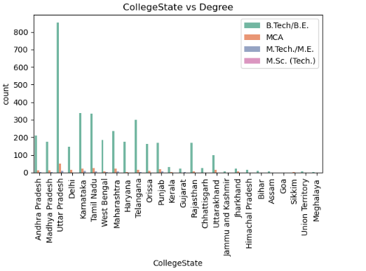
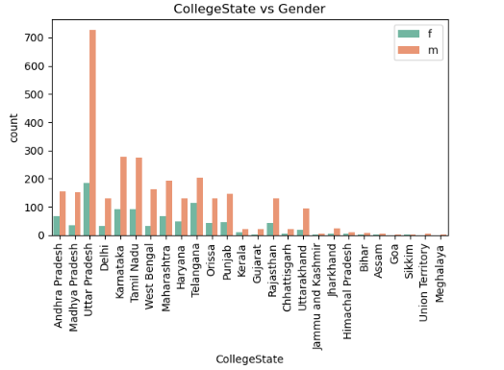
From the plot Gender Vs degree
Most of the male and female employees degree is B.Tech and then MCA
From the plot Degree and college State
most of the B.Tech graduates are from Uttar Pradesh
From the plot Gender and college State
from every state male employees are high compared to female employees.
and also most of the male employees are from Uttar Pradesh and then Karnataka.

Slide 13
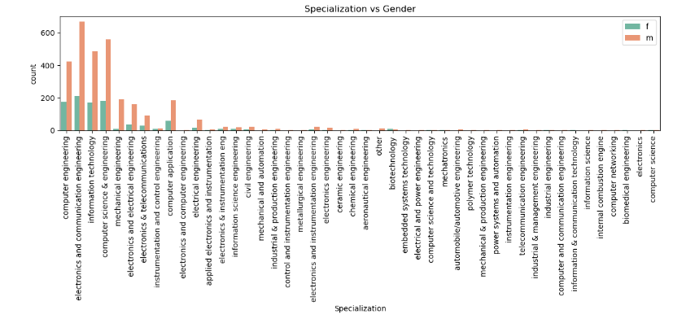
From the plot Specialization Gender Vs Gender
Both Male and female employees specialization Electronics and communication engineering and computer Science engineering.
But the male count is high in specialization

Slide 14
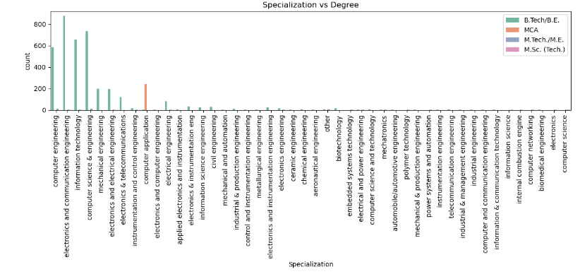
From the plot Specialization vs Degree
In degree B.Tech is the one most of the graduates are from.
And in Specialization electronics and communication and computer Science engineering is top.

Slide 15
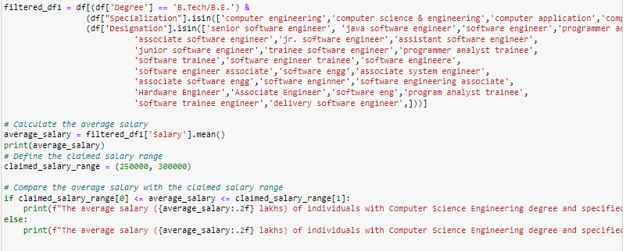
RESEARCH QUESTIONS
1.Times of India article dated Jan 18, 2019 states that “After doing your Computer Science Engineering if you take up jobs as a Programming Analyst, Software Engineer, Hardware Engineer and Associate Engineer you can earn up to 2.5-3 lakhs as a fresh graduate.” Test this claim with the data given to you.
359845.6057007126
The average salary (359845.61 lakhs) of individuals with Computer Science Engineering degree and specified job titles does not fall within the claimed salary range.
-Here the hypothesis is failed

Slide 16
Is there a relationship between gender and specialization? (i.e. Does the preference of Specialization depend on the Gender?)
Contingency Table:
Specialization | aeronautical engineering | applied electronics and instrumentation | automobile/automotive engineering | biomedical engineering | biotechnology | ceramic engineering | chemical engineering | civil engineering | computer and communication engineering | computer application | computer engineering | computer networking | computer science | computer science & engineering | computer science and technology | control and instrumentation engineering | electrical and power engineering | electrical engineering | electronics | electronics & instrumentation eng | electronics & telecommunications | electronics and communication engineering | electronics and computer engineering | electronics and electrical engineering | electronics and instrumentation engineering | electronics engineering | embedded systems technology | industrial & management engineering | industrial & production engineering | industrial engineering | information & communication technology | information science | information science engineering | information technology | instrumentation and control engineering | instrumentation engineering | internal combustion engine | mechanical & production engineering | mechanical and automation | mechanical engineering | mechatronics | metallurgical engineering | other | polymer technology | power systems and automation | telecommunication engineering
Gender
f | 1 | 2 | 0 | 2 | 9 | 0 | 1 | 6 | 0 | 59 | 175 | 0 | 1 | 183 | 2 | 0 | 0 | 17 | 0 | 10 | 28 | 212 | 0 | 34 | 5 | 3 | 0 | 0 | 2 | 1 | 2 | 0 | 8 | 173 | 9 | 0 | 0 | 0 | 0 | 10 | 1 | 0 | 0 | 0 | 0 | 1
m | 2 | 7 | 5 | 0 | 6 | 1 | 8 | 23 | 1 | 185 | 425 | 1 | 1 | 561 | 4 | 1 | 2 | 65 | 1 | 22 | 93 | 668 | 3 | 162 | 22 | 16 | 1 | 1 | 8 | 1 | 0 | 1 | 19 | 487 | 11 | 4 | 1 | 1 | 5 | 190 | 3 | 2 | 13 | 1 | 1 | 5

Slide 17
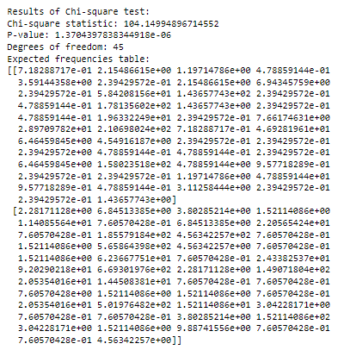
There is a significant relationship between gender and specialization.

Slide 18
CONCLUSION
most of the employees are from B.Tech and also they are mostly male candidates.
most of theirs college state is Uttar Pradesh.
Both Male and female employees specialization Electronics and communication engineering and computer Science engineering.
From every state male employees are high compared to female employees.
From Research Questions
The candidates from the specialization Computer science engineering and if they took up jobs as a Programming Analyst, Software Engineer, Hardware Engineer and Associate Engineer can earn greater than 3.5 lakhs as a fresh graduate.
There is a significant relationship between gender and specialization.

Slide 19

THANK YOU

